Slide 1
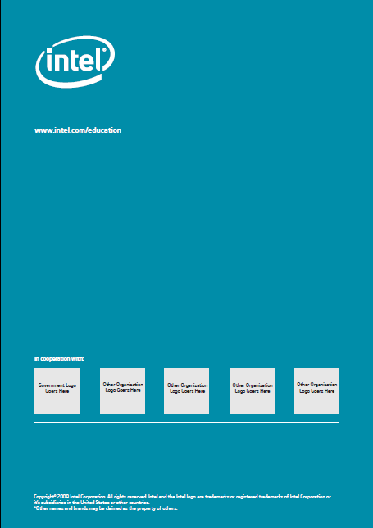
Intel Easy Steps Co-Branding Options
The norm for co-branding is to place the partner logo on the back cover of the program materials.
If the implementing partner organization requests it, we also permit placement of their logo on the front cover as indicated in the examples below.
Any other co-branding scenarios must receive approval from Intel (contact the RESCT)
Acceptable
Not Acceptable
Back Cover
(Normal placement
of partner logo)
Front Cover Examples
(Acceptable alternatives to back cover)
Don’t change the Intel® Easy Steps name (except for localizing).
Don’t change the Intel logo.
Do follow the usage guidelines.

